Slide 1
CS143 Entity Relation (ER) Model
Professor Junghoo “John” Cho

Slide 2
Entity-Relationship (E/R) Model
Q: How should we design tables in our database?
Tables are not “given”
”Good” tables may not be easy to come up with
E/R model: graphical, intuitive and “informal” representation of information on database
Used to “capture” what we learn from domain experts/database users
Not directly implemented by DBMS
Tools exists to automatically convert E/R model into tables
Two main components
Entity sets and relationship sets

Slide 3
Entity Set
Entity: “thing” or “object” in real world
E.g., I, this book, UCLA
Entity set: a set of entities (objects). Like a class in OOP
Rectangle in ER
Attribute: property of entities. “fields”
Ellipsis in E/R
sid
name
dept
cnum
name
office
sec
email
addr
Students
Classes
Faculty
age
GPA
title
unit
title

Slide 4
Entity Set
Entities with attributes can be thought as “tuples” (or records)
(301, John, 13 Hilgard, 18, 3.3), (303, James, 12 De Neve, 19, 2.5), …
Key: a set of attributes that uniquely identifies an entity in an entity set
Underline in E/R
All entity sets in E/R need a key
sid
name
dept
cnum
name
office
sec
email
addr
Students
Classes
Faculty
age
GPA
title
unit
title

Slide 5
Relationship Set
Relationship: “connection” between entities
Relationship set: a set of relations of the same kind
Diamond in ER
Relationships can be thought as “edges” between entities
Relationships can have attributes
Not all entities have to participate in a relationship
sid
name
grade
dept
cnum
quarter
name
office
sec
email
addr
Students
Take
Classes
Teach
Faculty
age
GPA
title
unit
title

Slide 6
Cardinality of Relationships
Cardinality: how many times entities participate in a relationship?
One-to-one One-to-many Many-to-many
Total participation
every entity participates in the relationship at least once
Double line in E/R model
E1
R
E2
E1
R
E2
E1
R
E2

Slide 7
Meaning of Cardinality
Q: What does it mean
Many-to-one in Teach?
One-to-one in Teach?
Double-line between Classes and Teach?
Double-line and arrow between Teach and Faculty?
Double lines at both sides of Teach vs one-to-one of Teach. Are they the same?
Students
Take
Classes
Teach
Faculty

Slide 8
General Cardinality Notation
Label an edge with “1..h”
The entity participates in the relationship between 1 and h times
* means unlimited
Don’t get confused: for one-to-many relationship, “0..*” appears on the “one” side and “0..1” appears on the “many” side
E1
R
E2

Slide 9
N-ary Relationship
We may need more than binary relationship sometimes
Example: Students, TA’s, and Classes
All TA’s help all students
Each student is assigned to a particular TA
Students
Classes
TAs
Students
Classes
TAs

Slide 10
Roles
We can designate a “role” to each entity set that participate in a relationship set
Labels on edges of a relationship in E/R model
Useful if an entity set participates more than once in a relationship
Partner
Students

Slide 11
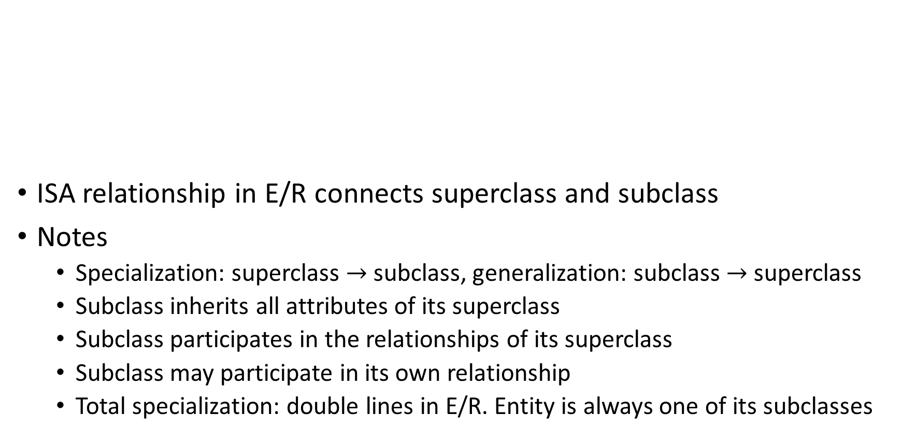
Superclass and Subclass
ISA relationship in E/R connects superclass and subclass
Notes
Specialization: superclass $→$subclass, generalization: subclass $→$ superclass
Subclass inherits all attributes of its superclass
Subclass participates in the relationships of its superclass
Subclass may participate in its own relationship
Total specialization: double lines in E/R. Entity is always one of its subclasses
Students
ISA
ForeignStudents
DomesticStudents

Slide 12
Weak Entity Set
Weak Entity Set: An entity set without a unique key
Double rectangle and double diamond in E/R model
Part of its key comes from one or more entity sets it is linked to
Owner entity set: entity set providing part of the key
Identifying relationship: relationship between a weak entity set and owner entity set
Double diamond in E/R model
Discriminator: attributes in a weak entity set that become part of the key
sid
name
ProjectNum
addr
Students
Submit
ProjectReport
age
GPA

Slide 13
E/R for Stores and Products
All products are either “private-label products” (like Kirkland shoes at Costco) or “national-brand products” (like Kleenex Tissue)
Every product is manufactured by exactly one manufacturer (like 7up by Coke company, etc.)
Every private-label product is carried by exactly one chain store (eg, Kirkland shoes by Costco)
Some national-brand products may not be carried by any chain store

Slide 14
E/R for Stores and Products
All products are either “private-label products” or “national-brand products”
Every product is manufactured by exactly one manufacturer
Every private-label product is carried by exactly one chain store
Some national-brand products may not be carried by any chain store
Manufacturers
MadeBy
Products
Chain Stores
Carries
ISA
National-brand Products
Carries
Private-label Products

Slide 15
E/R Design Principles
Often it is not clear what choices to make
One gigantic entity set with many attributes vs many smaller entity sets?
Attribute vs Entity set?
General rule of thumb for good design: avoid redundancy
Saying the same thing more than once
Space waste and potential inconsistency

Slide 16
E/R Design Example
Faculty(name, addr) are instructors of Class(dept, cnum, title)
Things to consider for entity set vs attribute
Do we need more attributes than keys?
Is it one-to-one relationship?
Create multiple entity sets for many-to-many or many-to-one relationships
dept
cnum
title
dept
cnum
name
title
addr
Classes
VS
Classes
Teach
Faculty
fname
faddr

Slide 17
E/R to Relation
Converting E/R diagram to tables is mostly straightforward
Automatic conversion tools exists
(Strong) entity set: one table with all attributes
Relationship set: one table with keys from the linked entity sets and its own attributes
Rename attributes when names conflict by prefixing entity set name
Weak entity set: one table with its own attributes and keys from owner entity set
No table for identifying relationship set

Slide 18
Example Conversion from E/R to Relation
num
grade
Student(name, addr) Class(cnum, title) TA(name, addr) Faculty(name, addr)
Teach(name, cnum) Take(Student.name, cnum, TA.name, quarter) Partner(coder, tester)
ProjectReport(name, num, grade)
ProjectReport
Submit
name
addr
name
addr
TA
cnum
title
coder
Partner
Student
Take
Class
tester
quarter
Teach
ISA
ForeignStudent
HonorStudent
Faculty
country
fellowship
name
addr

Slide 19
Conversion of Subclass(es)
Two approaches
One table for each subclass with its own attributes and the key of its superclass
Student(name, addr) ForeignStudent(name, country) HonorStudent(name, fellowship)
One gigantic table for the super class that includes all attributes
Student(name, addr, country, fellowship)
NULL values for missing attributes
addr
name
Student
ISA
ForeignStudent
HonorStudent
country
fellowship

